Slide 1

Project on National Data Portals in Samoa and Fiji Workshop 2 Experience Sharing and SDMX/.Stat Suite Tools 27-31 January 2025 Suva, Fiji
.Stat Suite: Data Lifecycle Manager

Slide 2


Learning objectives
At the end of this session, you will be able to:
Find the various components of the .Stat Suite Data Lifecyle Manager
Explain what each component is designed for
Find SDMX artefacts through the DLM
Manage SDMX Data and Metadata through the DLM

Slide 3
Outline
Find Structures
Manage Structure
Export
Transfer
Upload
Delete
Link referential metadata
Manage Data
Transfer
Upload
Delete
Export dump
Logbook
Manage user access

Slide 4
https://stats-test-dlm.pacificdata.org/

Slide 5

not accessible in anonymous mode

Slide 6
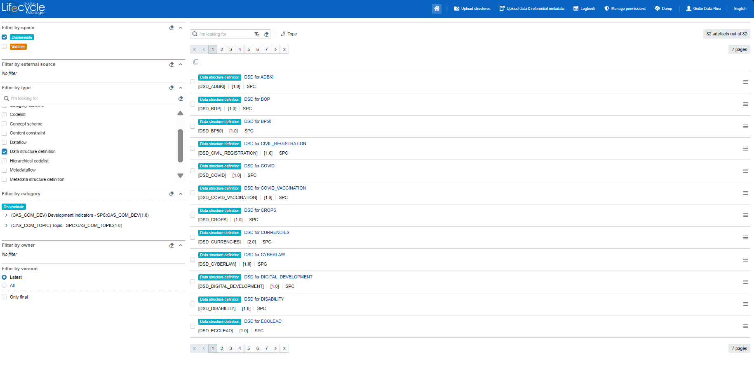
Overview

Slide 7
Overview
header
Navigation menu:
upload structures
upload data & metadata
logbook
manage permissions
dump
account
locale

Slide 8
Overview
selectors and filters
space
type
category
owner
version

Slide 9
Overview
artefacts
keyword search
display options
artefact menu

Slide 10
Find
step 1:
Select a Space
for SPC: Disseminate and Validate

Slide 11
Find
step 2:
Select one or more Types
e.g., Dataflow, DSD, Concept scheme, …

Slide 12
Find
step 3 (optional):
Filter by category, version, owner, …

Slide 13

Find
step 4 (optional):
Search for Keyword

Slide 14
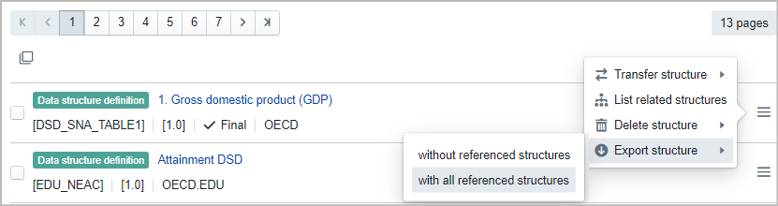
Manage Structures: export
data structure artefacts will be downloaded in SDMX-ML format (an XML dialect)
all referenced structures:
e.g. DSD with all referenced codelists, content constraint, dataflow, category scheme, etc, …

Slide 15
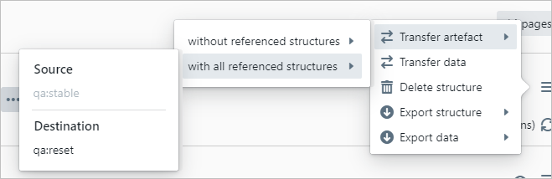
Manage Structures: transfer
Transfer from one space to another.
Useful if you define structures in staging and then deploy in production
all referenced structures:
e.g. DSD with all referenced codelists, content constraint, dataflow, category scheme, etc, …

Slide 16
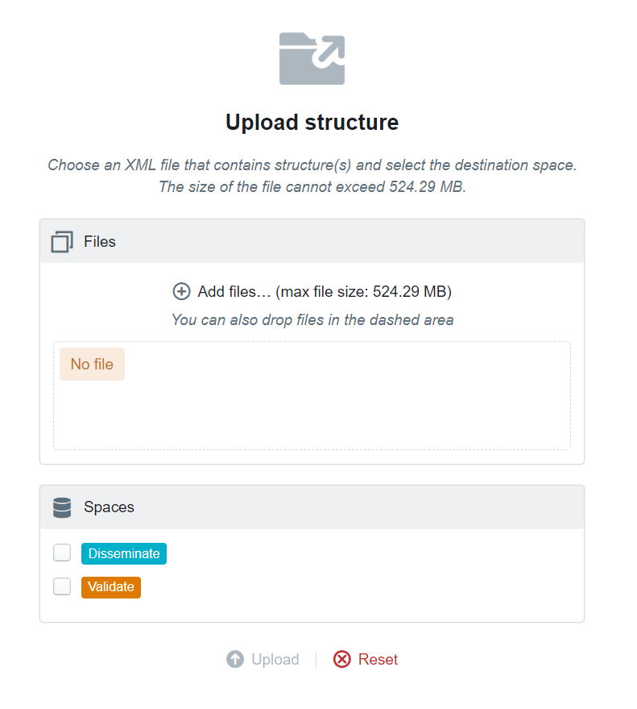
Manage Structures: upload
Upload structures:
In SDMX-ML (XML) format and ready (tip: peer review!)
In correct order:
Concepts
Codelists
DSD
Dataflow
Constraints
Categorizations
One-at-a-time (better for debugging)

Slide 17
Manage Structures: upload
Upload structures:
In SDMX-ML (XML) format and ready (tip: peer review!)
In correct order:
Concepts
Codelists
DSD
Dataflow
Constraints
Categorizations
One-at-a-time (better for debugging)

Slide 18
Manage Structures: upload
To check outcome:
- Logbook (we’ll see later)
- Email
- Notifications on screen (red, yellow, green) Errors are informative (sometime)

Slide 19
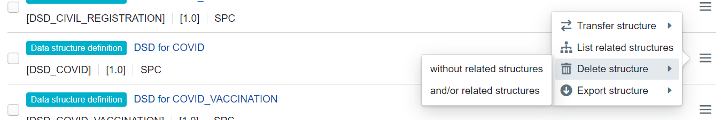
Manage Structures: delete
To change some structural definitions, it might be needed to delete the artefacts.
When this happens, artefacts must be deleted in the appropriate order according to their dependency tree.

Slide 20
Manage Structures: delete
To change some structural definitions, it might be needed to delete the artefacts.
When this happens, artefacts must be deleted in the appropriate order according to their dependency tree.

Slide 21
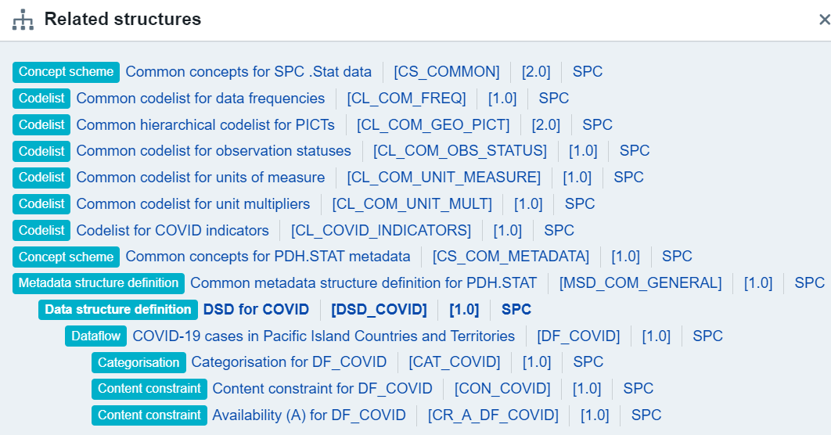
Manage Structures: delete
When this happens, artefacts must be deleted in the appropriate order according to their dependency tree, as made available by list related structures.

Slide 22
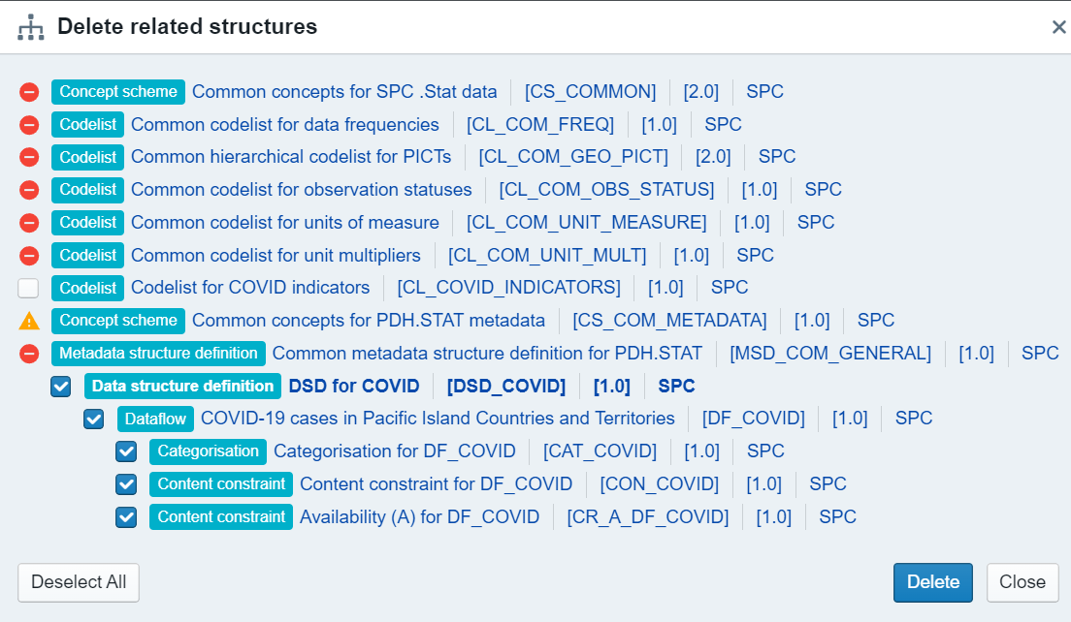
Manage Structures: delete
DLM will inform us about what needs to go when we try to delete a structure. (and what we can’t delete as it is a dependency for other structures)

Slide 23
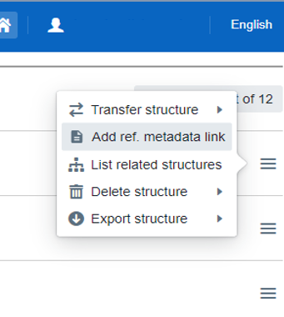
Manage Structures: link
only available for DSDs in internal data space without an already existing MSD link

Slide 24
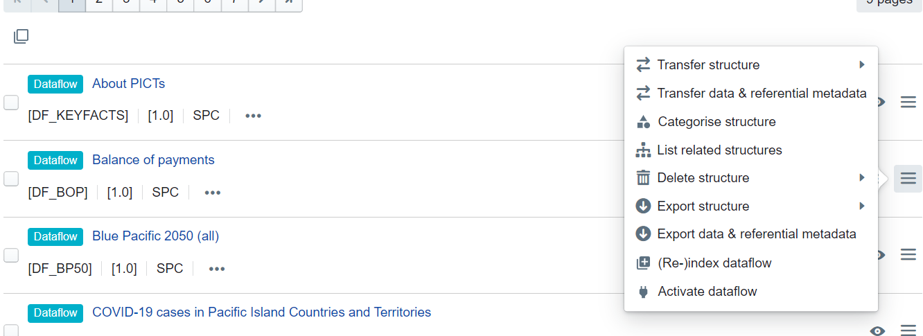

Manage Data: transfer
Transfer from one space to another.
Useful if you define structures in staging and then deploy in production

Slide 25
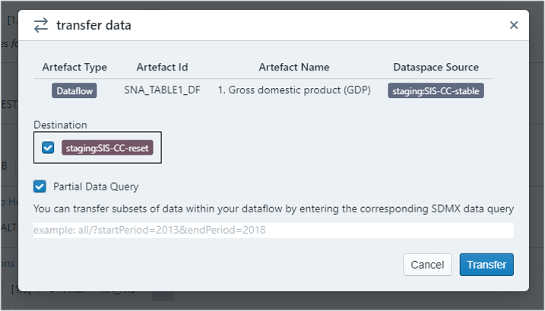
Manage Data: transfer
Transfer from one space to another.
Partial data transfers are possible specifying a filtering SDMX query

Slide 26
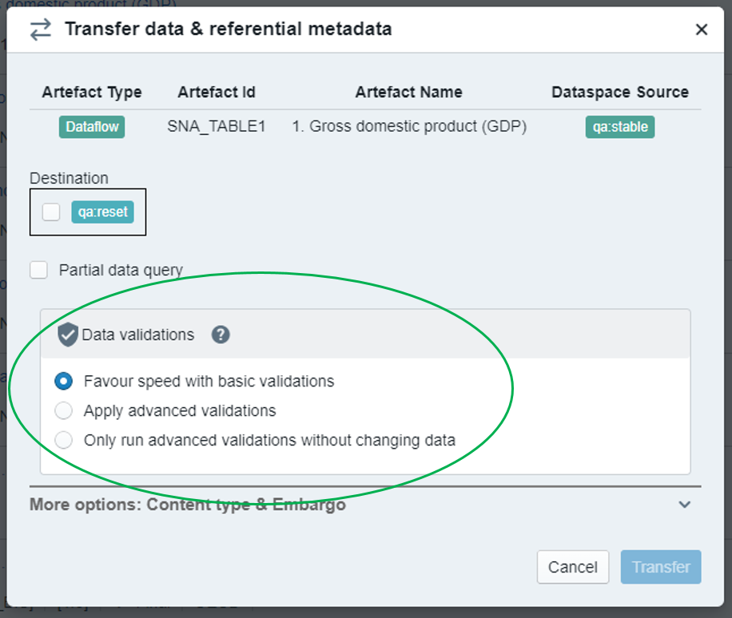
Manage Data: transfer
Prefer advanced validations:
SDMX compliance
allowed/complete dimensions values
representation requirements duplicated coordinates
consistent non-observational values
mandatory attribute values.
It provides detailed error explanations

Slide 27
Manage Data: transfer
To check outcome:
- Logbook (we’ll see later)
- Email
- Notifications on screen (red, yellow, green) Errors are informative (sometime)

Slide 28
Manage Data: upload
The DLM upload options:
CSVs as SDMX data or referential metadata files for either observation and attribute values or for referential metadata attribute values
Excel data files together with Excel Data Definition (in xml)
data and referential metadata must be uploaded through separate import files

Slide 29
Manage Data: upload
CSVs as SDMX data or referential metadata files
Referential metadata can be uploaded only after having uploaded the related Metadata Structure Definition (MSD) and its concepts (in one or more Concept Schemes)

Slide 30
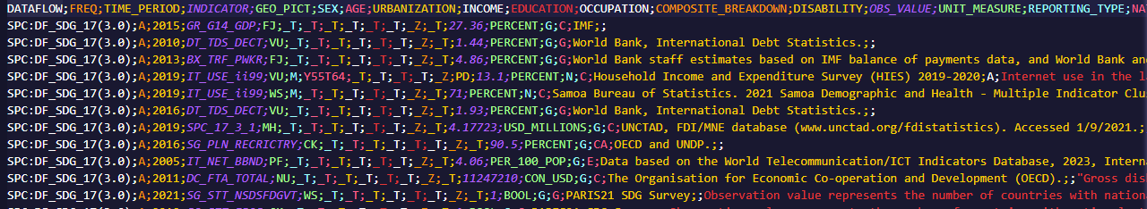
Manage Data: upload
CSVs as SDMX data or referential metadata files
Definition for CSV format

Slide 31







Manage Data: upload
CSVs as SDMX data or referential metadata files
DF identifier
IDs
IDs
Values

Slide 32
Manage Data: upload
Excel data files
data organised in spreadsheet tables according to a table description
provided with the Excel file through an additional Excel Data Descriptor
It’s rather complex!

Slide 33
Manage Data: delete
possible Actions on upload:
Information
Merge: data for incremental update
Replace: data for replacement Delete: data to be deleted
SDMX-CSV 2.0 an ACTION column (after the structure identification column) defines which action for each individual row (observation or attribute(s)). If absent, then Merge.
SDMX-ML Delete action is provided per dataset

Slide 34
Manage Data: delete
Delete everything: through DLM, drop and reload DF
Delete something: Delicate operation, as it is necessary to specify what data to download

Slide 35
Manage Data: delete
Deletion happens at the lowest level of detail provided.
If a row contains:
only the identification information of the structural artefact (dataflow, data structure definition, …) then all data for the given artefact will be deleted
the structure identification and only partial dimension values then all observations and all attribute values relating to those dimension values will be deleted
the structure identification, partial dimension values and values for some of the related attributes then only these attribute values will be deleted
the structure identification and full dimension values then the related observation and all its observation-level attribute values will be deleted
structure identification, full dimension values as well as values for some of the related measures and attributes then only these measure and observation-level attribute values will be deleted

Slide 36
Manage Data: delete
Deletion happens at the lowest level of detail provided.
measures and attribute values to be deleted must be non-empty
OR all measure and attribute values must be empty

Slide 37
Manage Data: delete
Delete whole dataflow:
Delete all observations (values and attributes):
Delete all observation values
Delete all attributes
Delete whole time series DIM_1=A, DIM_2=B
Delete observation and observation-level attributes attached to DIM_1=A, DIM_2=B, TIME_PERIOD=2021

Slide 38
Manage Data: delete
here for the details

Slide 39
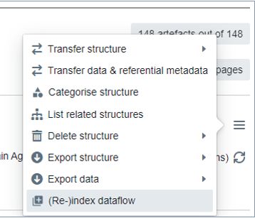
Manage Data: indexing
(re)indexing a dataflow is necessary for
searchability and browsability
DF needs to
be categorised (under an SDMX CategoryScheme)
have data associated to it
have publicly accessible structures and data

Slide 40
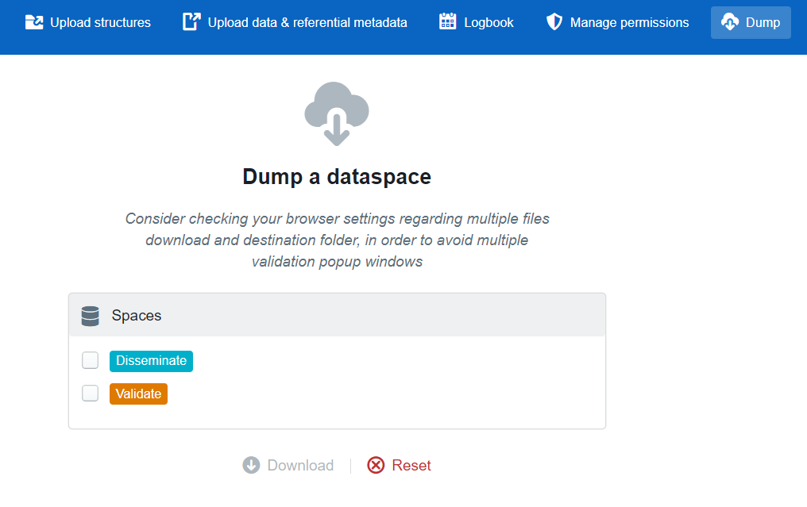
Export
one-click extraction of the whole content of a data space.
All structure objects (artefacts), data and referential metadata of the selected data spaces are downloaded and saved in files in the download folder defined by the web browser settings of the user

Slide 41
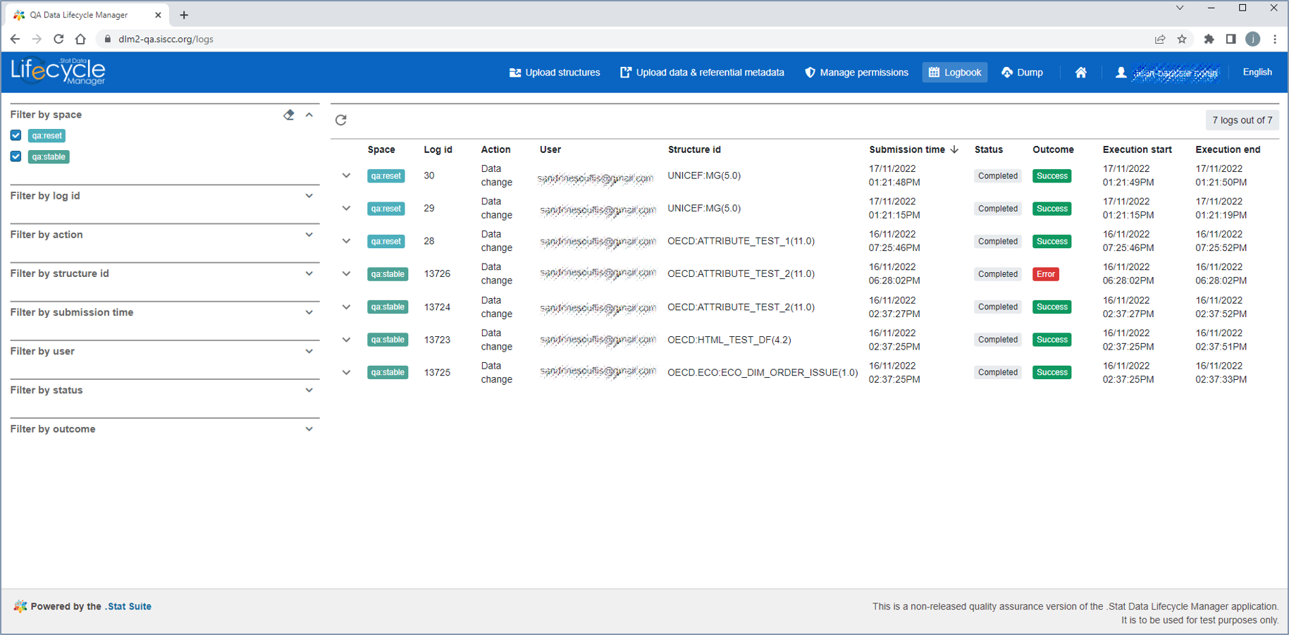
Log
logbook can be filtered
logbook presents one action log per line

Slide 42
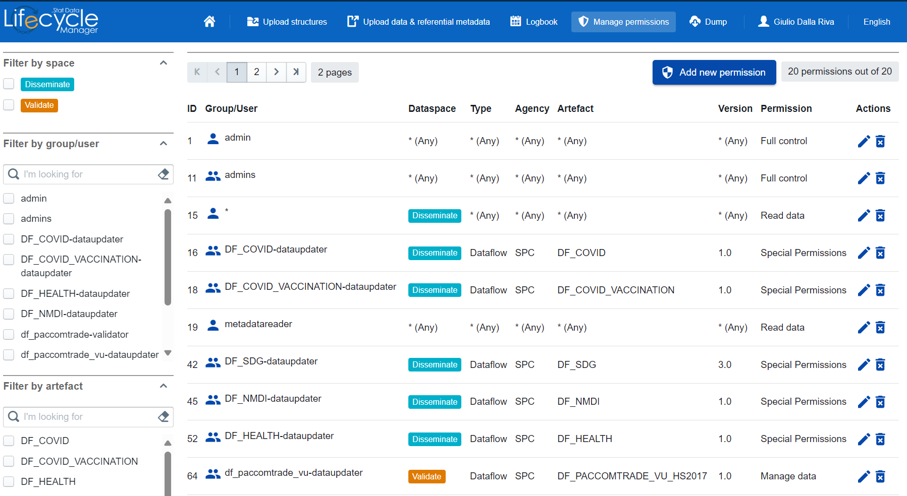
Manage Access

Slide 43
Manage Access
multi-selection filters by:
- space
- group/user
- agency
- permission type
- artefact (permission can be artefact specific)

Slide 44
Manage Access
List of roles

Slide 45
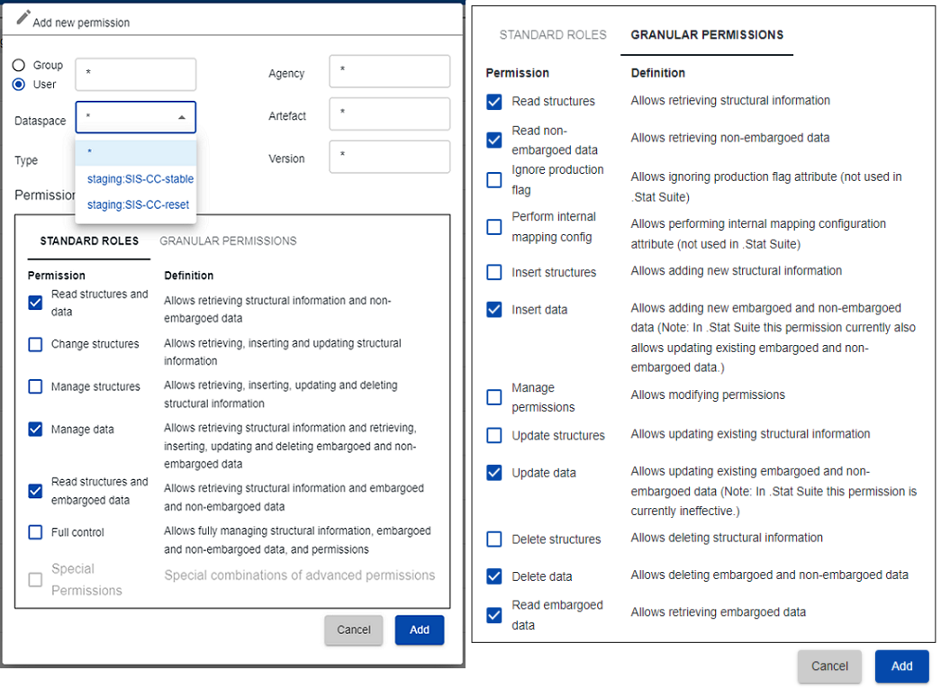
Manage Access
If you are admin, you can modify these permissions

Slide 46
Exercise
Have fun! Go to SPC’s test environment.
Copy, modify, and re-upload some structures (change their name to something you can remember!).
Delete the structures you created.

Slide 47
Discussion and Q&A

